Slide 1
SPOTIFY TOP TRACKS
What makes a track popular?
What makes a track belong to a specific genre?
Full project: https://github.com/MilenaTrajanoska/spotify_top_tracks_analysis

Slide 2
ANALYSIS
01
02
03
CLASSIFICATION
REGRESSION
CLUSTERING
Linear and non-linear classification modles comparison
Linear and non-linear regression models comparison
Basic and advanced clustering methods

Slide 3
Data collection
2
4
1
3
Initial data set from Kaggle
Feature enrichment with artist followers and artist popularity from spotify’s api
Collecting top tracks for 2020 from spotify’s api
Hierarchical grouping of genres

Slide 4
Data description
Attribute | Description | Type
title | Track title | Nominal
artist | Main artist in the track | Nominal
followers | Number of followers the main artist has in million | Continuous (ratio)
artist_popularity | Internal measure of how much an artist is popular according to Spotify | Continuous (interval)
year | The year in which the track was trending | Ordinal
tempo | The tempo of the track or beats per minute | Continuous (ratio)
energy | The energy of the track (intensity and activity) | Continuous (ratio)
danceability | How easy the track makes you dance | Continuous (ratio)

Slide 5
Data description
Attribute | Description | Type
loudness | How loud is the track | Continuous (ratio)
liveness | How likely is the track a live recording | Continuous (ratio)
valence | Does the track sound more positive or negative | Continuous (ratio)
duration | Duration of the track in ms | Continuous (ratio)
acousticness | How likely is the track acoustic | Continuous (ratio)
speechiness | Presence of spoken words in the track | Continuous (ratio)
track_popularity | Measure of how popular the track is | Continuous (interval)
top genre | One most suitable genre for the track | Nominal
is_dance_pop | Does the track belong to the dance pop genre (the most frequent genre in the top tracks with 52% prevalence) | Binary

Slide 6
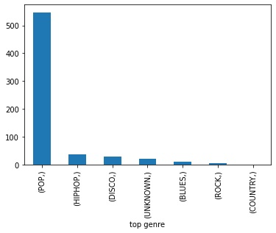
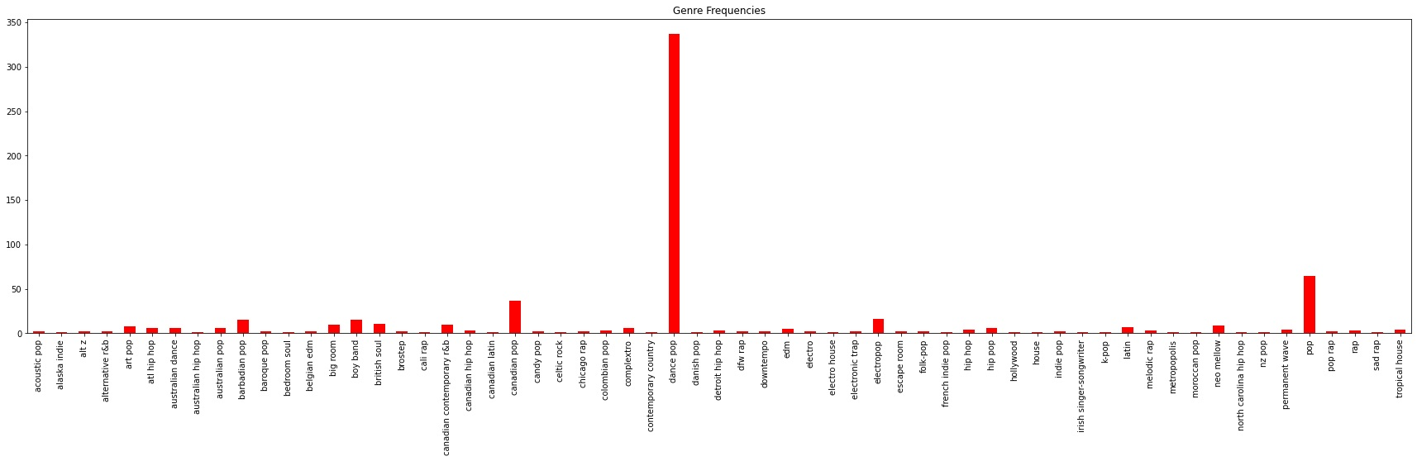
Data preprocessing
Missing value imputation
Values scale adjustment
Hierarchical grouping of genres

Slide 7
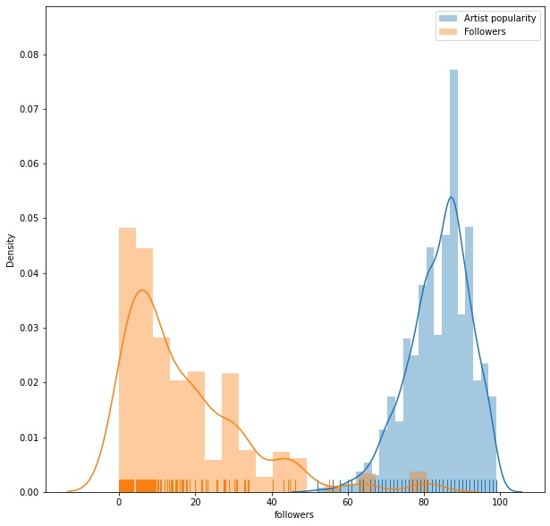
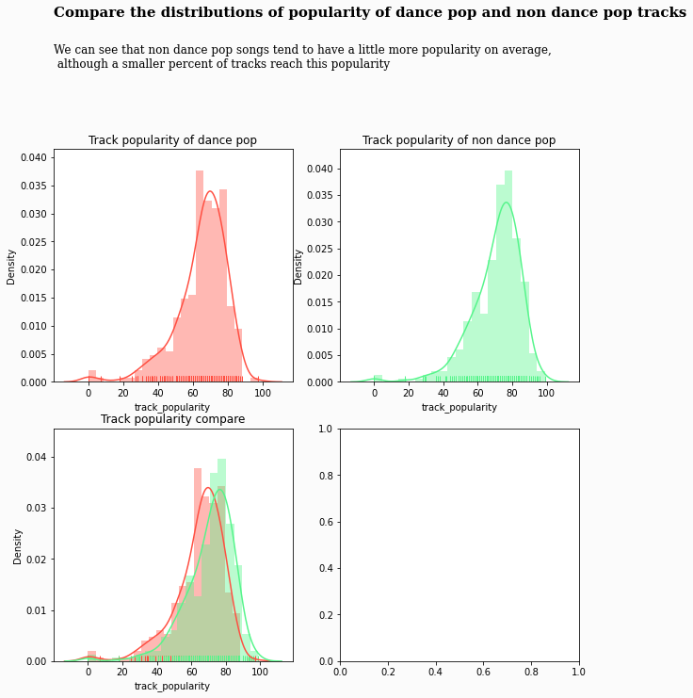
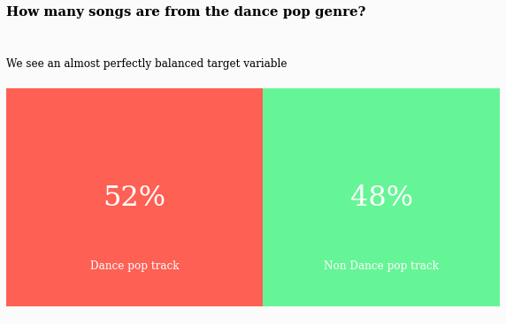
Visualizations
Track popularity
dance pop vs non
dance pop
Missing values
Binary target distribution

Slide 8
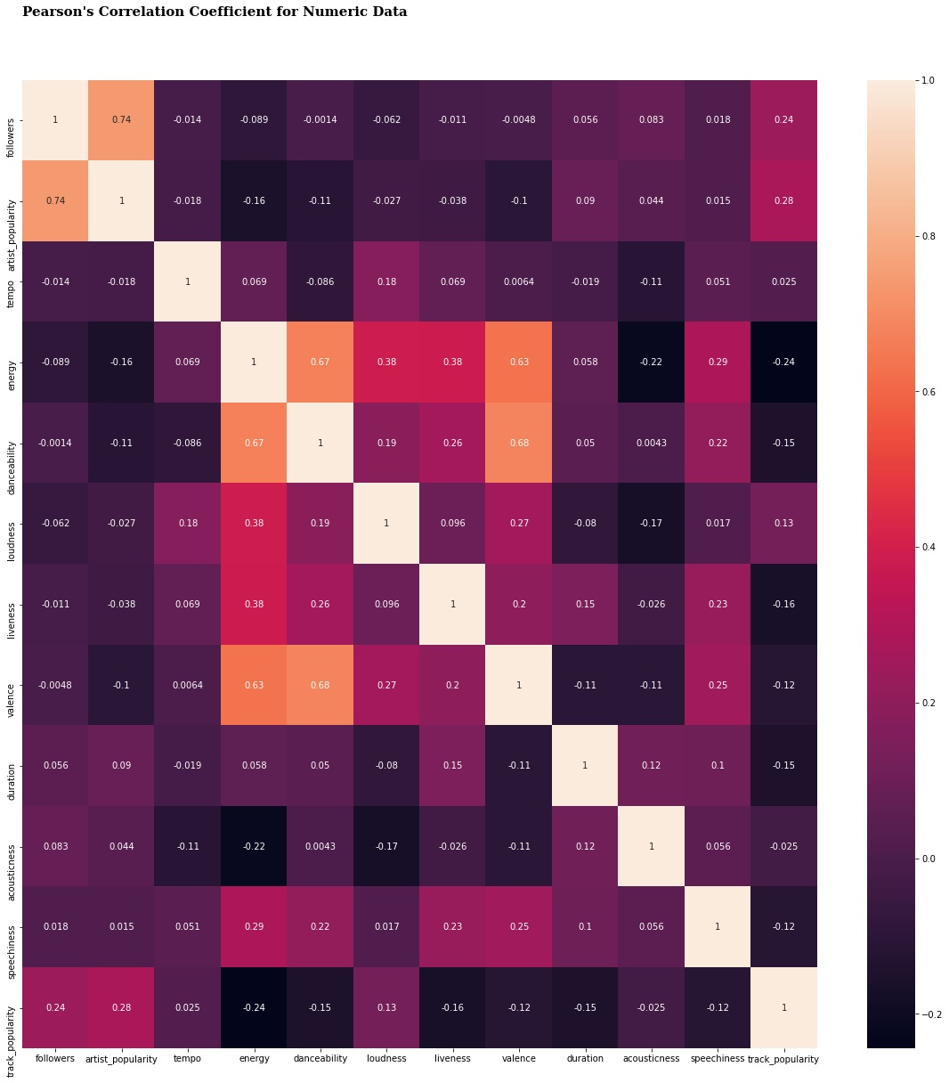
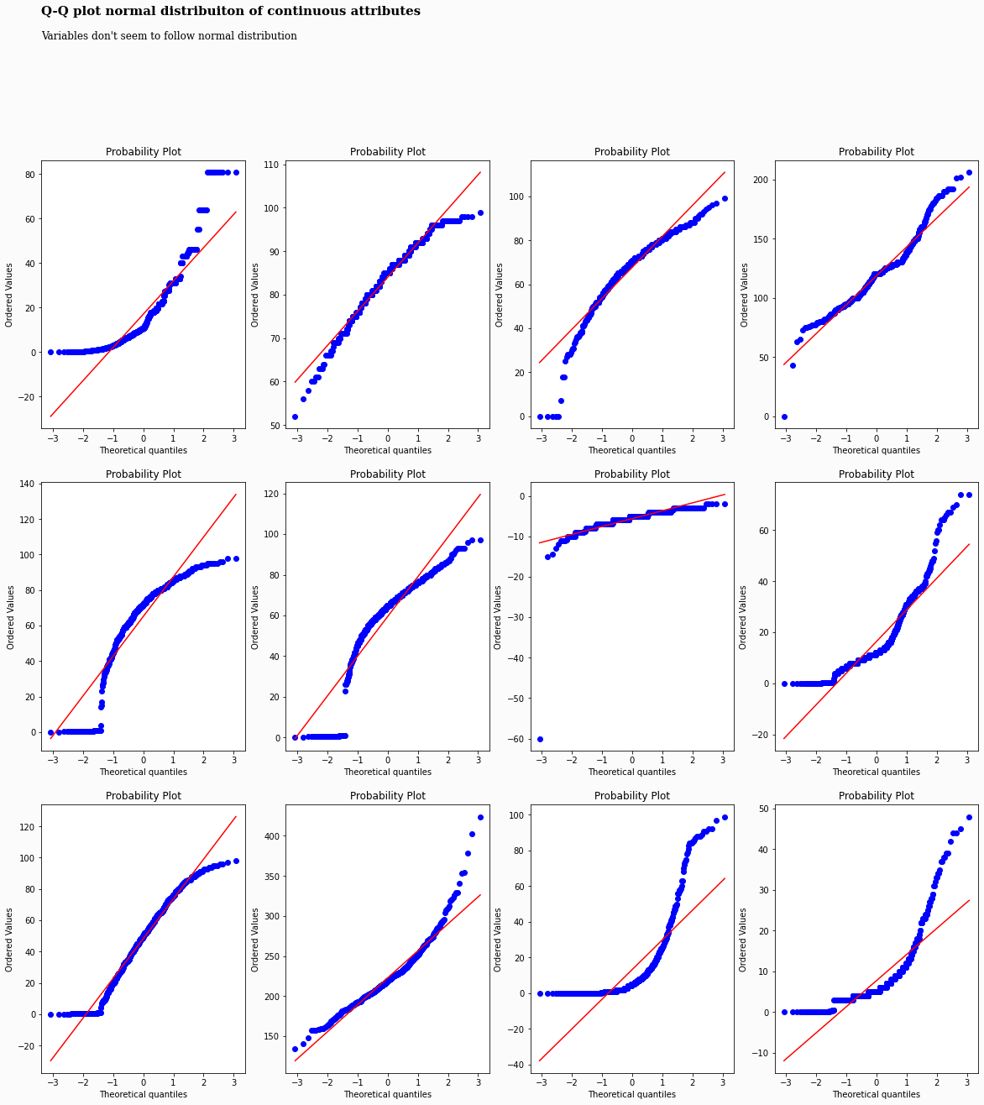
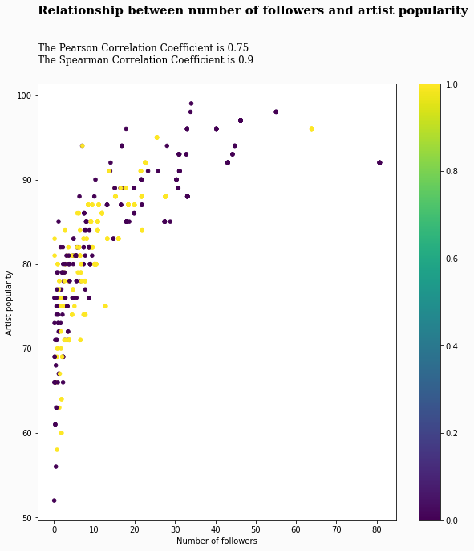
Visualizations
Pearson correlation
Followers vs artist popularity
Q-Q plot normal distribution

Slide 9
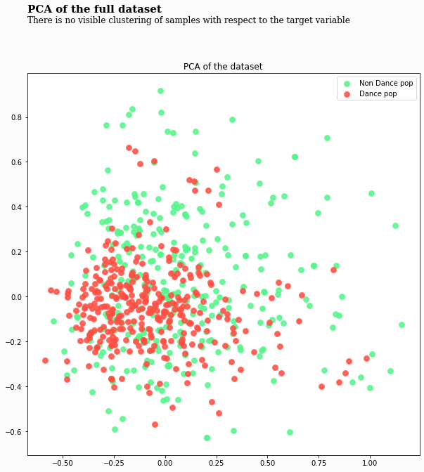
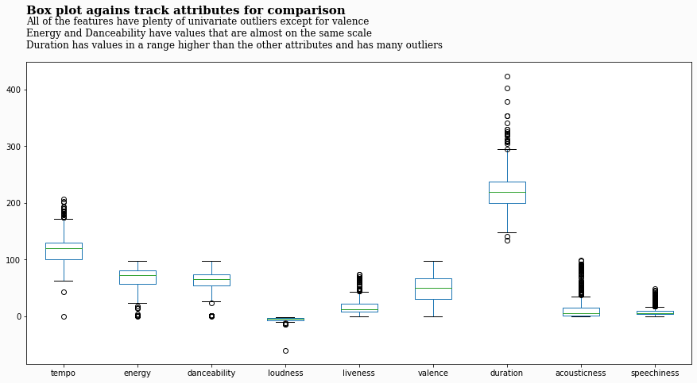
Visualizations
PCA with binary labels
Box plots

Slide 10
BINARY CLASSIFICATION NAÏVE BAYES

Slide 11
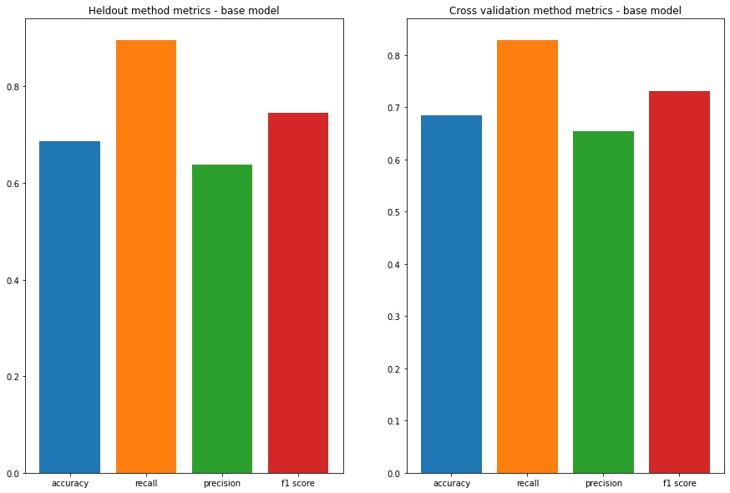
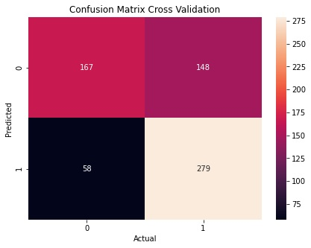
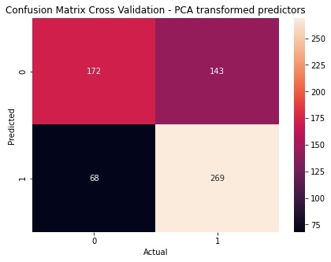
Naïve Bayes – base model
Original features
PCA transformed
0.83
0.83
0.80
0.68
0.73
0.72
0.68
0.65
0.68
0.65
0.65

Slide 12
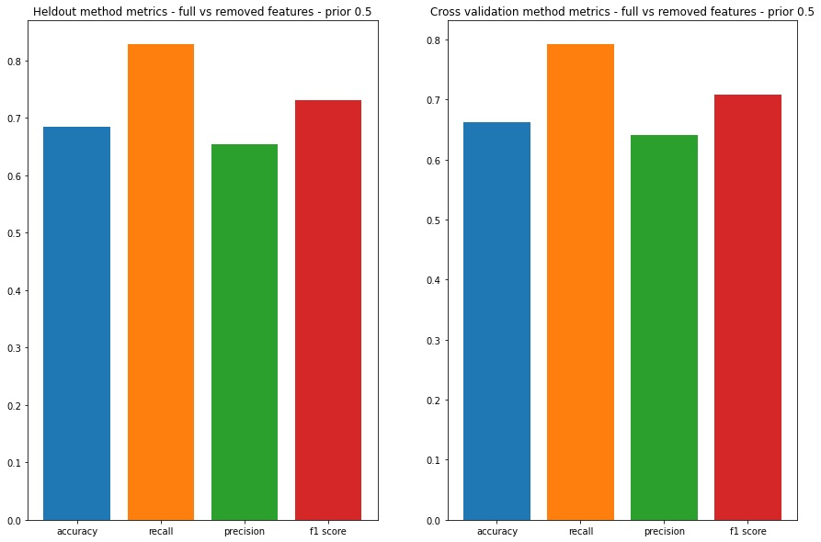
Naïve Bayes – model with uniform prior Results 5-fold cv
All features
Without correlated features
0.83
0.80
0.73
0.71
0.68
0.65
0.66
0.64

Slide 13
BINARY CLASSIFICATION DECISION TREE

Slide 14
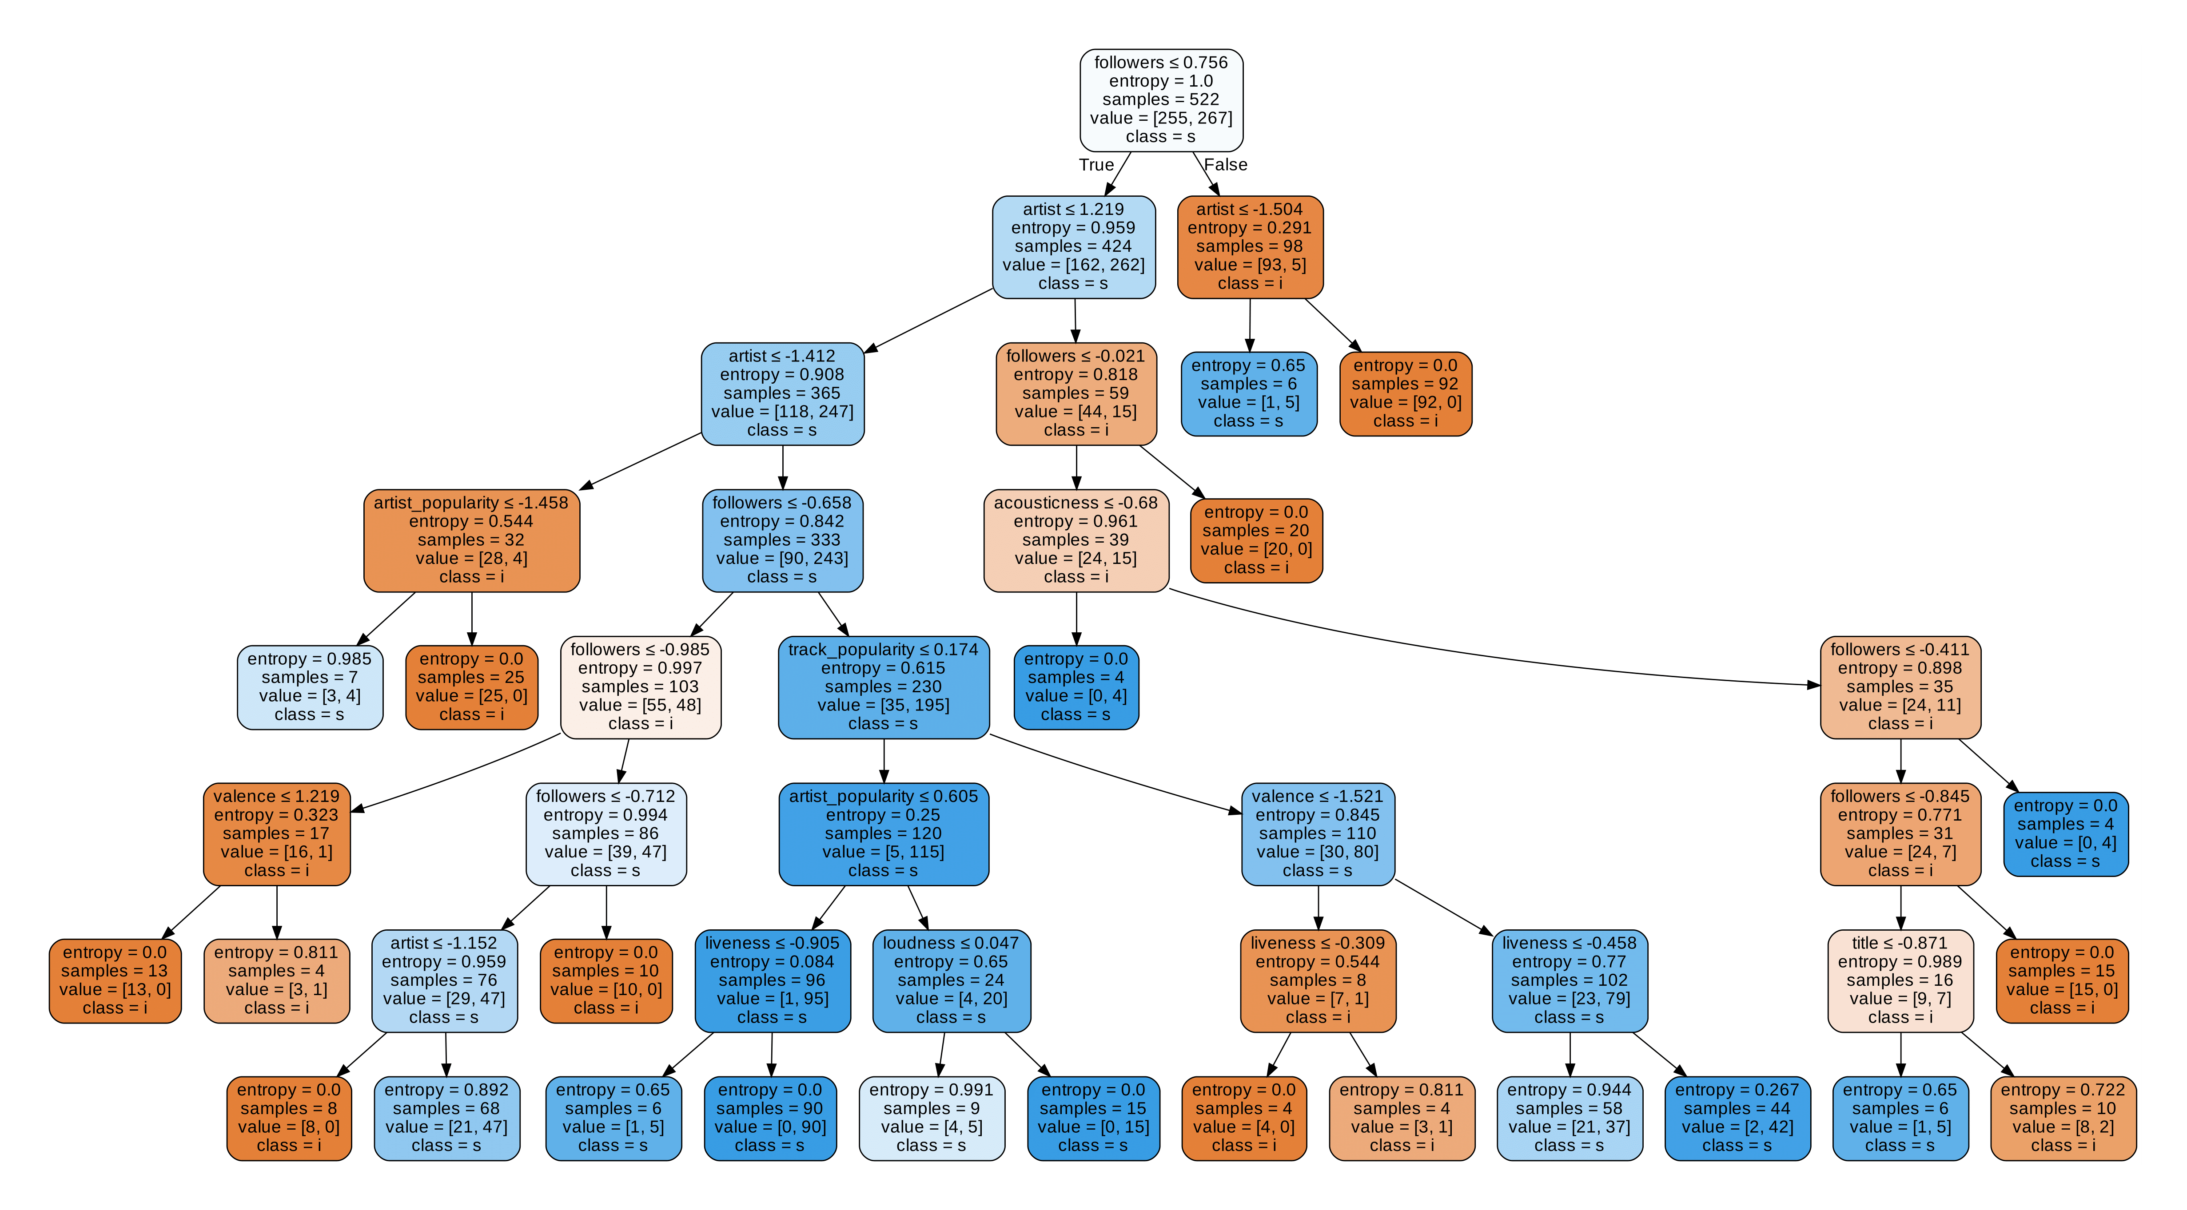
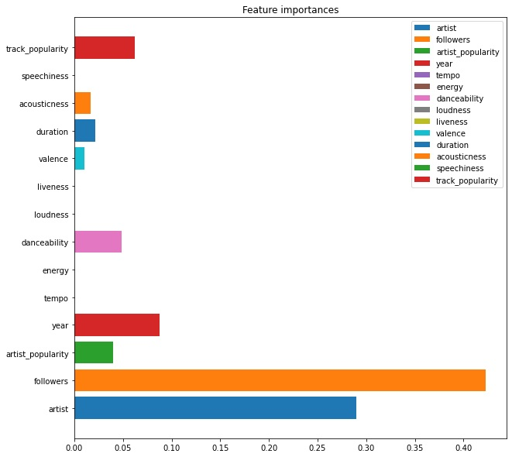
Decision tree - unpruned

Slide 15
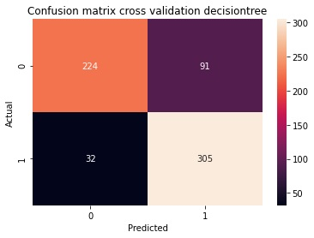
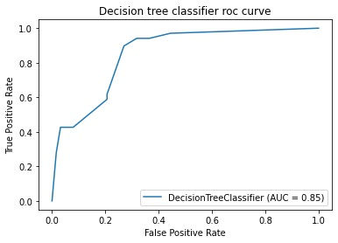
Decision tree – unpruned Results 5-fold cv

Slide 16
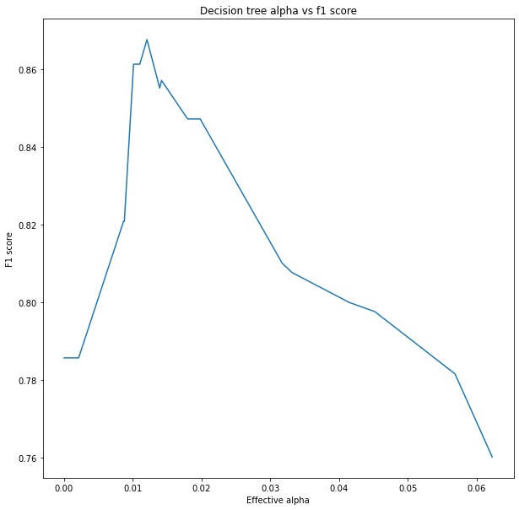
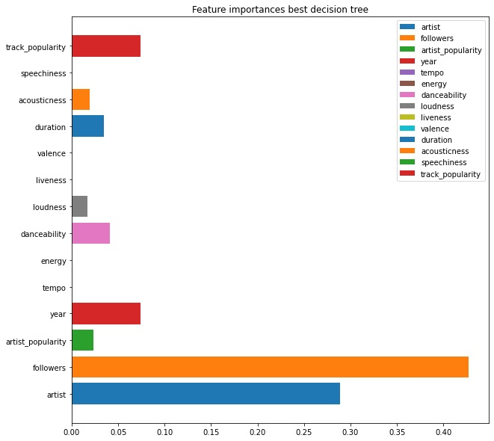
Decision tree – pruned

Slide 17
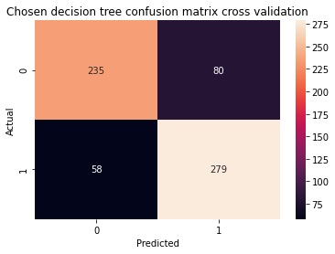
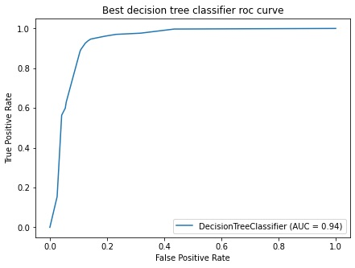
Decision tree – pruned Results 5-fold cv

Slide 18
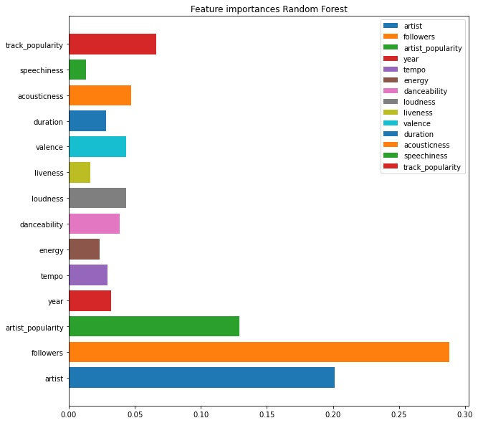
Random forest
Grid search 5-fold cross validation
Maximizing AUC score

Slide 19
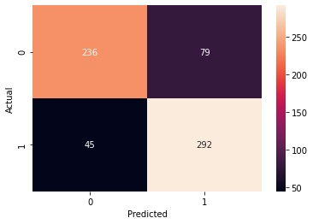
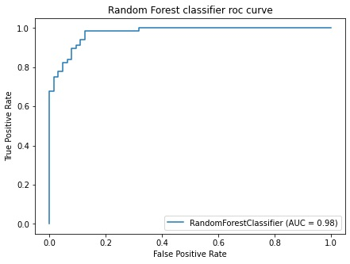
Random forest Results 5-fold cv

Slide 20
COMPARING METRICS
Unpruned decision tree
Pruned decision tree
Random forest
Accuracy: 0.81
Recall: 0.91
Precision: 0.77
F1 score: 0.83
Accuracy: 0.79
Recall: 0.83
Precision: 0.78
F1 score: 0.80
Accuracy: 0.81
Recall: 0.87
Precision: 0.79
F1 score: 0.82

Slide 21
BINARY CLASSIFICATION KNN

Slide 22
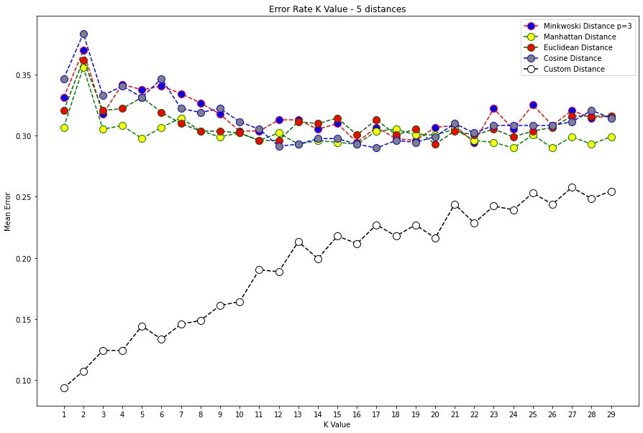
Evaluating different metrics
def custom_metric(x, y):
score = 0
val = (x[0]!=y[0])**2 #for artist (nominal)
score += val
count = 0
for xi, yi in zip(x[1:], y[1:]):
if count == 2:
score += (abs((xi-yi) / 9))**2 #for year (ordinal)
else:
score += (xi-yi)**2
count += 1
return np.sqrt(score)

Slide 23
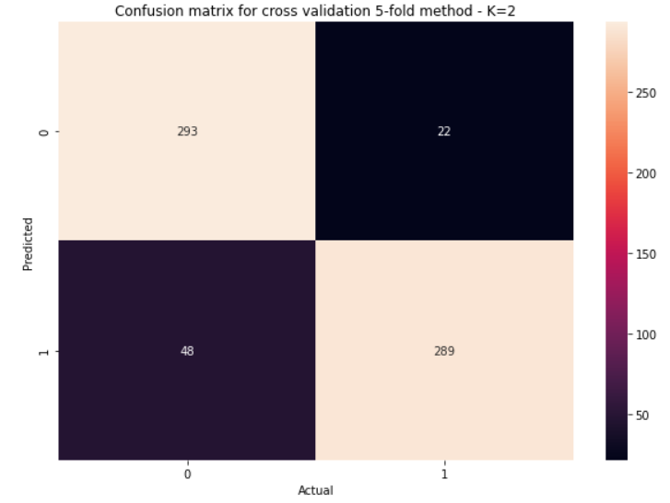
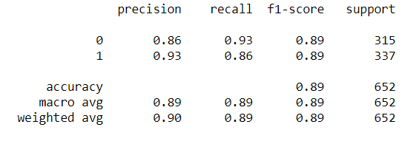
KNN 2 neighbors Results

Slide 24
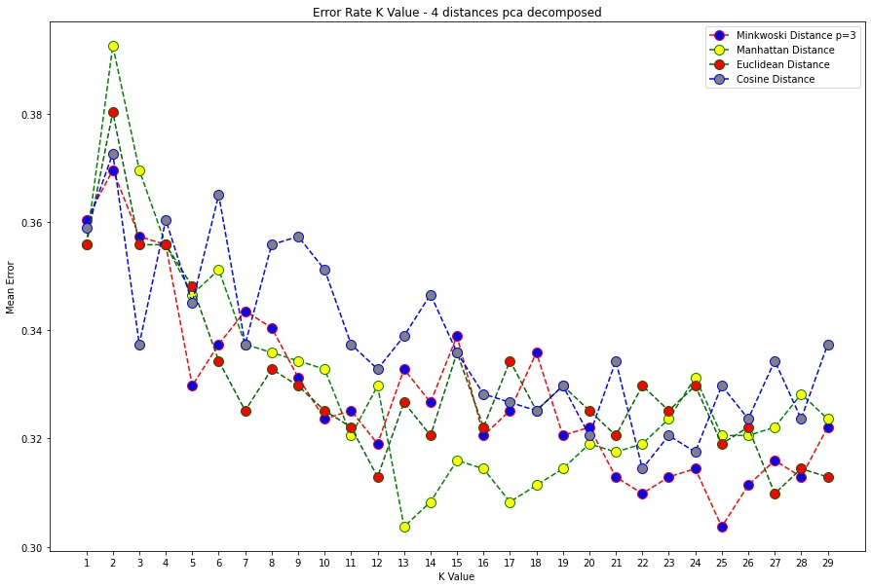
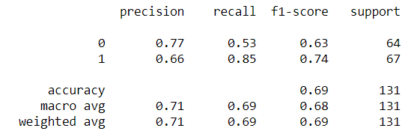
Dimensionality reduction
PCA dimensionality reduction 5 dimensions

Slide 25
LOGISTIC REGRESSION

Slide 26
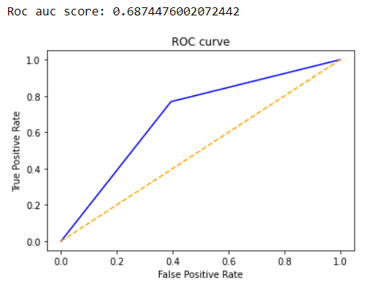
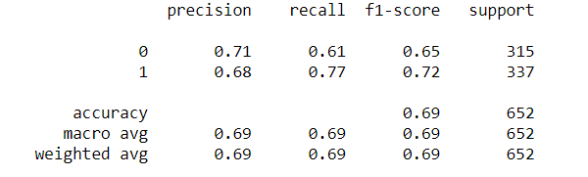
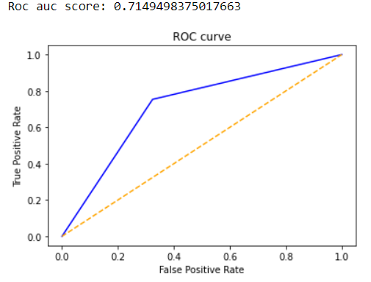
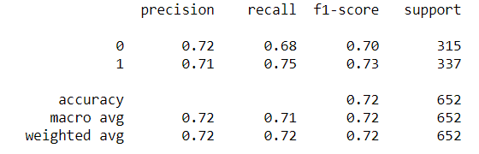
Logistic regression - base
Logistic regression – polynomial features (degree 2)

Slide 27
LINEAR DISCRIMINANT ANALYSIS

Slide 28
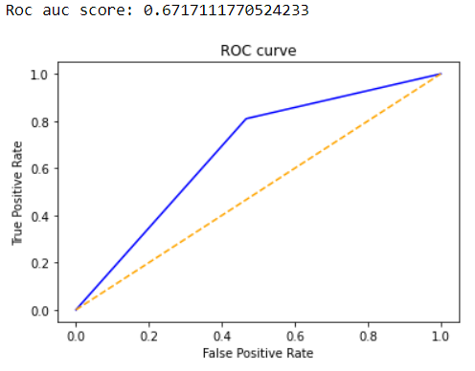
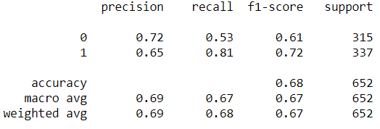
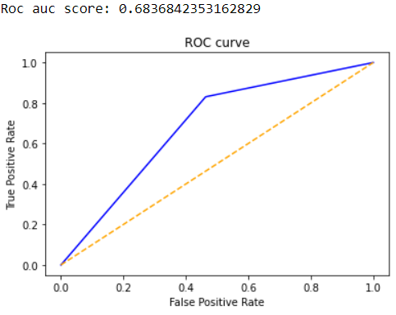
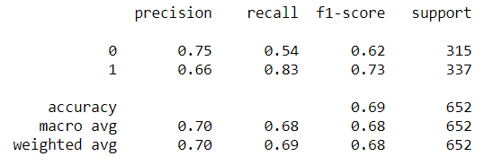
LDA
Standardize
Priors: [0.4, 0.5], Solver: lsqr
Grid search 5-fold cv
LDA – dimensionality reduction

Slide 29
ENSEMBLES

Slide 30
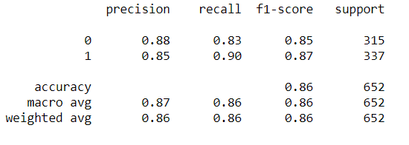
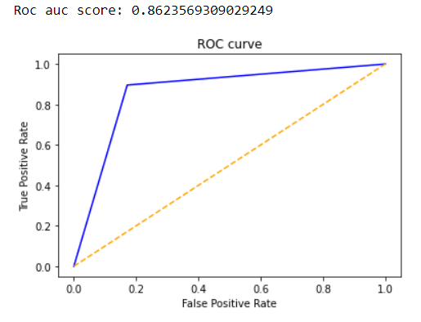
ENSEMBLES
BEST RESULTS:
Adaptive Boosting
Voting:
knn, decision tree, logistic regression, lda
Bagging:
Logistic regression, 10 estimators
Decision tree, 10 estimators
LDA, 10 estimators
Random forest, 10 estimators, criterion entropy
Extra trees, 10 estimators
Adaptive Boosting

Slide 31
EXTREME GRADIENT BOOSTING

Slide 32
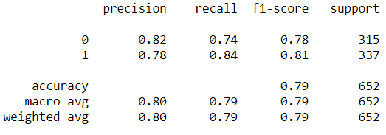
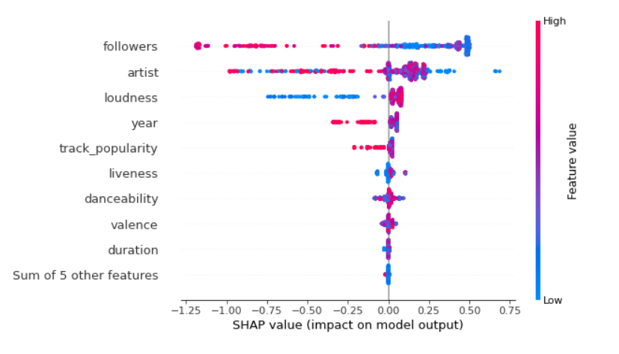
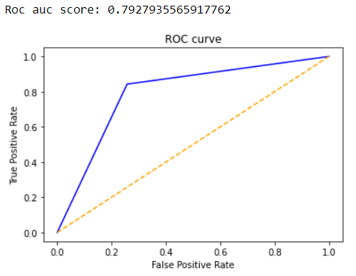
Results
Feature importance

Slide 33
ARTIFICIAL NEURAL NETWORK

Slide 34
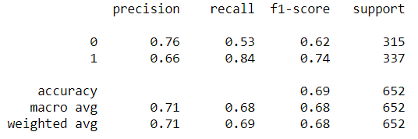
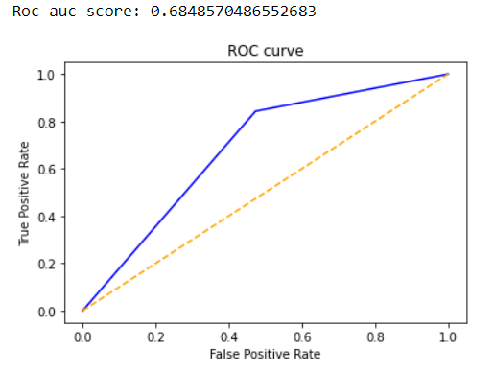
ANN
1 hidden layer, 32 neurons, relu activation
Output layer sigmoid activation
Loss: binary crossentropy, Optimizer: adam
150 epochs, mini-batch

Slide 35
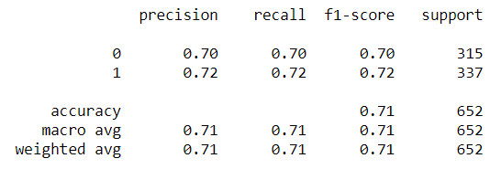
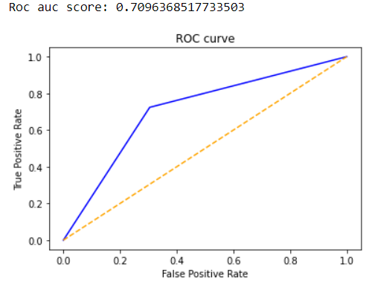
DNN
6 hidden layers, 3 dropout
Hidden layer activation: relu
Output layer activation: sigmoid
Loss: binary crossentropy, Optimizer: adam
150 epochs, mini-batch

Slide 36
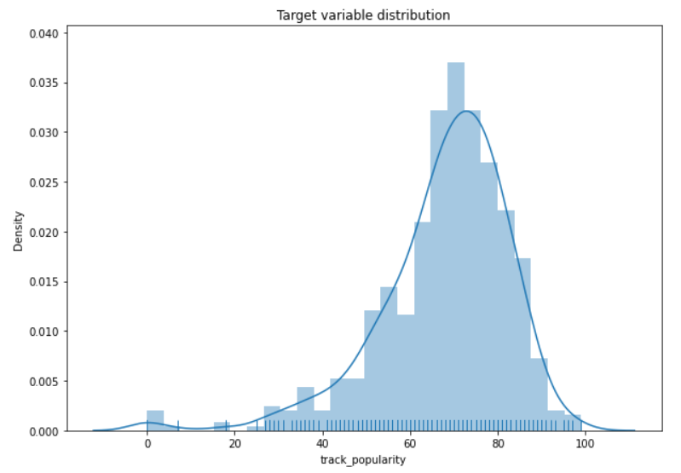
MULTICLASS CLASIFICATION

Slide 37
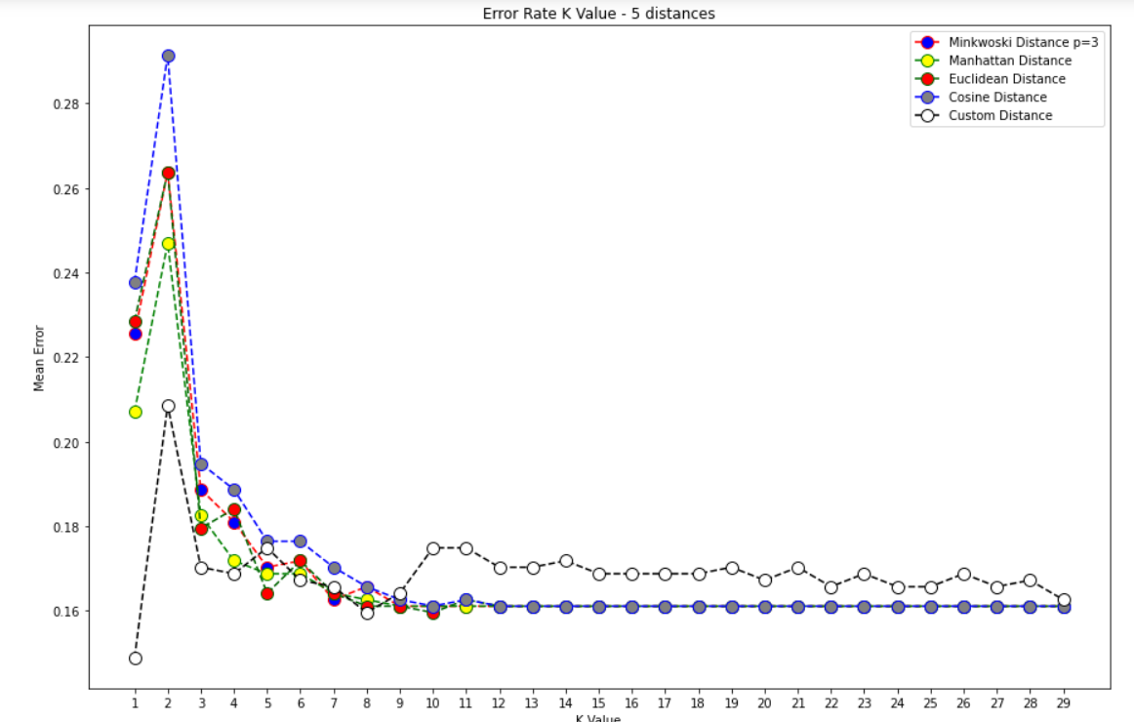
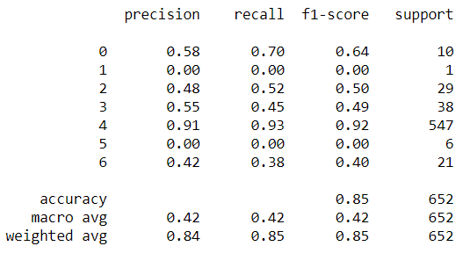
KNN multiclass

Slide 38

Logistic regression – one vs rest
Grid search with inner 5-fold cv for best parameters
Classifies all tracks as pop

Slide 39
LINEAR REGRESSION

Slide 40


Results
Error distribution

Slide 41


Recursive feature elimination
5-fold cv

Slide 42


Basis function expansion (degree 2)
5-fold cv

Slide 43


Lasso regression (L1)
Value of alpha
Feature coeficients

Slide 44


Results

Slide 45



Lasso + Basis function expansion

Slide 46



Ridge regression (L2)

Slide 47



Ridge + Basis function expansion

Slide 48
DECISION TREE & RANDOM FROEST

Slide 49


Decision tree
Leave one out cross validation
Grid search for maximum depth, minimum samples leaf node, minimum samples for split

Slide 50


Decision tree - Results
High variability
Non-zero centered errors
Not a normal distribution

Slide 51



Random Forest
Feature Importance
Grid search with internal cross validation 5-fold
Leave one out cross validation for predictions
Bimodal error distribution

Slide 52
SUPPORT VECTOR MACHINE

Slide 53



SVM – RBF kernel
Error distribution
Grid search with inner 5-fold cv
Leave one out cv for predictions

Slide 54



SVM – Polynomial kernel
Error distribution
Grid search with inner 5-fold cv
Leave one out cv for predictions

Slide 55



SVM – Linear kernel
Error distribution
Grid search with inner 5-fold cv
Leave one out cv for predictions

Slide 56
EXTREME GRADIENT BOOSTING

Slide 57



XGBoost - Results
Feature importance

Slide 58
ARTIFICIAL NEURAL NETWORK

Slide 59


ANN
1 hidden layer, 32 neurons, relu activation
Output layer linear activation
Loss: mse, Optimizer: adam
150 epochs, mini-batch 32 batch size

Slide 60


DNN
4 hidden layers
Hidden layer activation: relu
64, 32, 16 and 8 neurons
Output layer activation: linear
Loss: mse, Optimizer: adam
250 epochs, mini-batch : 32 batch size

Slide 61

K-MEANS CLUSTERING

Slide 62


K-means
K-means is sensitive to outliers
Using KNN – outlier detector to remove outliers

Slide 63

K-means result
Silhouette coef: 0.337

Slide 64
HIERARHICAL CLUSTERING

Slide 65


Hierarchical clustering
Different methods: single link, complete link, average link, ward
Best: ward
Clustering still not optimal

Slide 66


Hierarchical clustering

Slide 67
DBSCAN

Slide 68


DBSCAN
Calculate distances to n-th nearest neighbor
Choose epsilon with elbow method
2 neighbors, epsilon 0.73
Not suitable method for the data set

Slide 69
SELF ORGANIZING MAPS

Slide 70


SOM
25x25 gird of output neurons
Gaussian neighborhood function

Slide 71

SOM

Slide 72


Using K-means with SOM neuron vectors
Each data point is replaced with the neuron that is closest to it in the 25x25 grid
K-means on the neurons

Slide 73


Results

Slide 74
GAUSSIAN MIXTURE

Slide 75

Gaussian Mixture
Number of clusters | Covariance | Silhouette coefficient | Calinski Harabasz score
3 | tied | 0.107586 | 80.461163
Different number of clusters
Different covariance matrices: full, spherical, diagonal, tied
Best: 3 components, tied matrix

Slide 76


Results

Slide 77
Related work
Suh, Brendan Joseph. "International Music Preferences: An Analysis of the Determinants of Song Popularity on Spotify for the US, Norway, Taiwan, Ecuador, and Costa Rica." (2019). https://scholarship.claremont.edu/cmc_theses/2271/
Luo, Kehan. "Machine Learning Approach for Genre Prediction on Spotify Top Ranking Songs." (2018). https://cdr.lib.unc.edu/concern/masters_papers/ns064961b
Al-Beitawi, Zayd, Mohammad Salehan, and Sonya Zhang. "What Makes a Song Trend? Cluster Analysis of Musical Attributes for Spotify Top Trending Songs." Journal of Marketing Development and Competitiveness 14, no. 3 (2020): 79-91. https://www.proquest.com/openview/41a37854d2c51ea29ea8773c768728bb/1?pq-origsite=gscholar&cbl=536309

